Slide 1
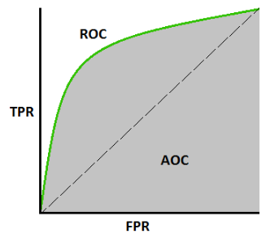

ROC Curve
ROC curve (Receiver Operating Characteristics) is a performance measurement for classification problem at various thresholds settings.

Slide 2
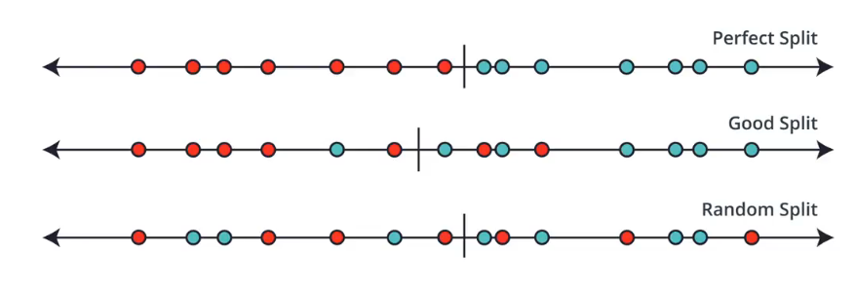
Threshold

Slide 3
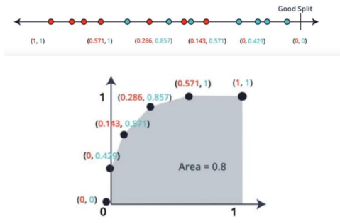

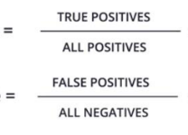


TPR
FPR

Slide 4
